Slide 1
Project 14: Bias and Variance Reduction in Off-policy Reinforcement Learning
Jierong Luo(jl5502)
Yihao Li(yl4326)
Supervisor: Dr. Henry Lam

Slide 2
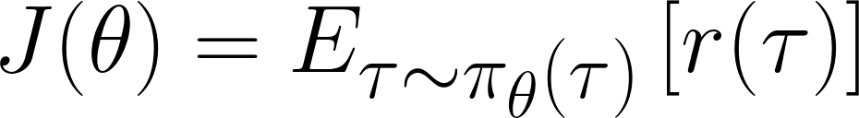
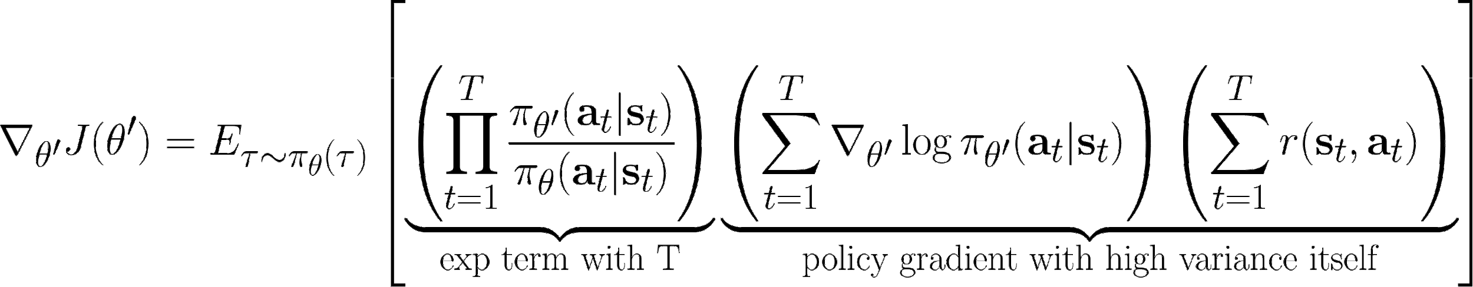
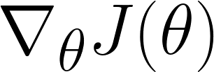
Background
Policy Gradient: the gradient of expectation of reward given a policy w.r.t. the parameters in the policy, i.e.:
when we have
do we have a good estimator for
?
Current off-policy gradient estimation method, with most of its derivations in articles published, inevitably suffered a exponential variance w.r.t. to the time horizon T.

Slide 3
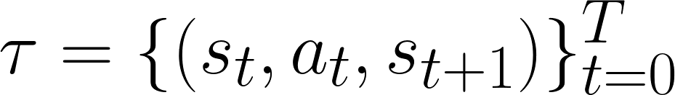
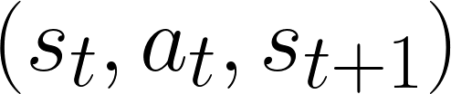
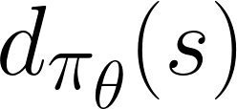
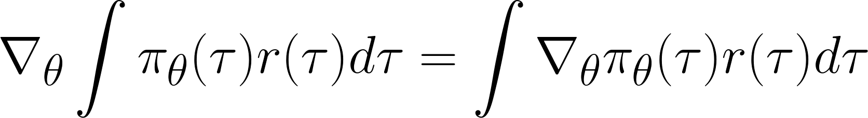
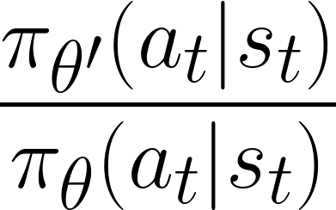
Our Idea
Inspired by Qiang Liu et al.[1], we no longer evaluate the reward by the whole trajectory
Rather, in a infinite-time-horizon problem, we analyze the the rollout record of triple and its distribution
Our theoretical assumptions:
The markov process should be aperiodic and irreducible.
is always well-defined
Trajectory-level policy gradient estimator:
(s,a,s’) triple-level policy gradient derived:
[1] Liu, Q., Li, L., Tang, Z., & Zhou, D. (2018). Breaking the curse of horizon: Infinite-horizon off-policy estimation. In Advances in Neural Information Processing Systems (pp. 5356-5366). https://arxiv.org/pdf/1810.12429.pdf

Slide 4
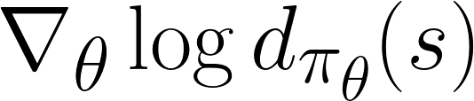
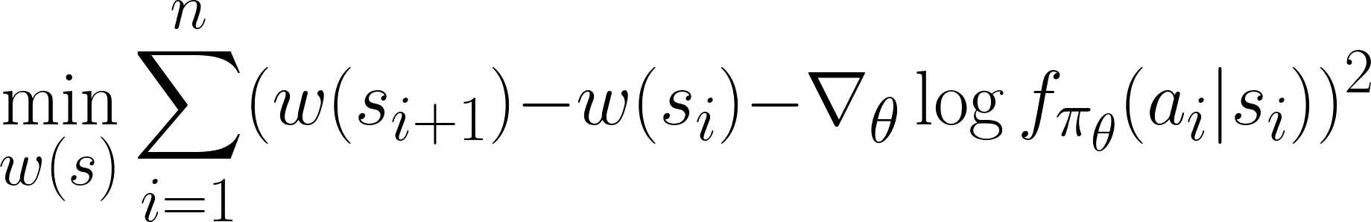
Derivative of log(d(s))
in
Theoretical side:
Under our assumptions, we derived a theorem as following:
A proper approximation w(s) of must satisfy that:
In practice:
solve the following least square problem:
This optimization result is translation-invariant. Under our assumptions, the expectation of the gradient of log-likelihood function is always zero. Therefore we calculate a solution first, then deducted its mean to obtain the real solution of w.

Slide 5
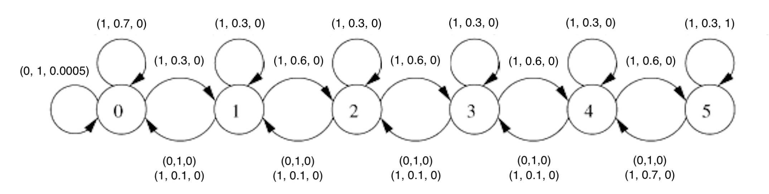
Experiment Setting
The Riverswim problem:
Initial state: s = 0 or 1 for probabiliy 50%
Action space: A = {0, 1}
Some modification:
To save the computational cost, modified some of the parameters.
To control the value from stack overflow, scaled the rewards from 5, 10000 to 5e-4 and 1
Riverswim’s graphical illustration, The triple on the graph is (action, probability, reward), modified from [2]
[2] Strehl, A. L., & Littman, M. L. (2008). An analysis of model-based interval estimation for Markov decision processes. Journal of Computer and System Sciences, 74(8), 1309-1331.

Slide 6
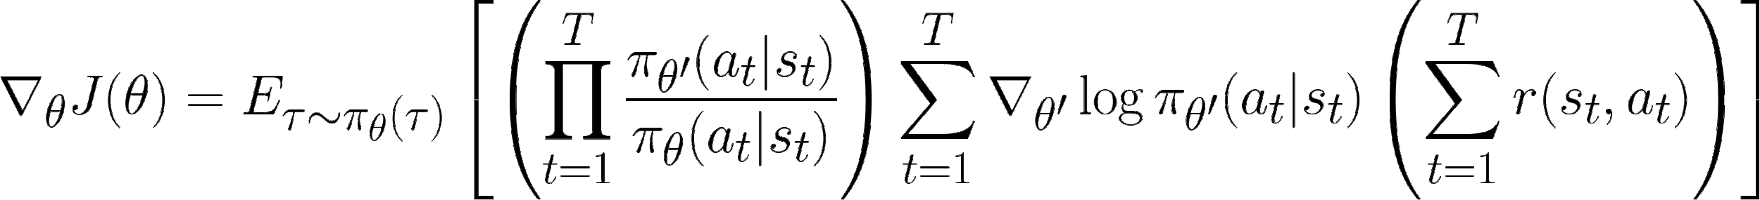
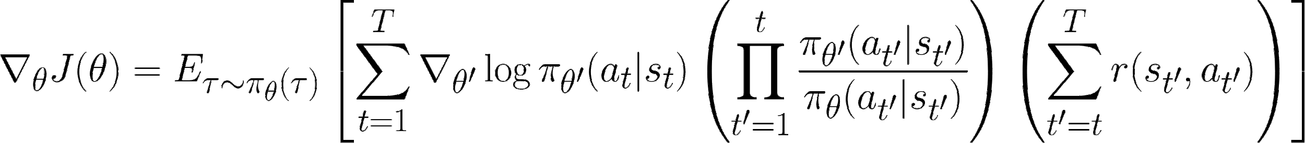
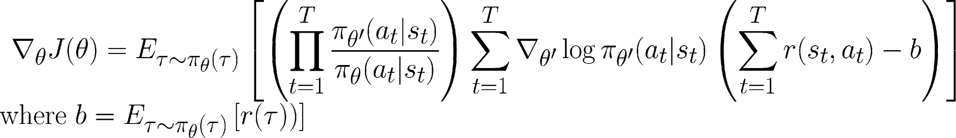
Benchmark methods
Benchmark: No variance control method applied
Variant control method “causality”: The future gradient cannot affect the past
Variant control method “Baseline”: The rewards from each trajectories are normalized

Slide 7
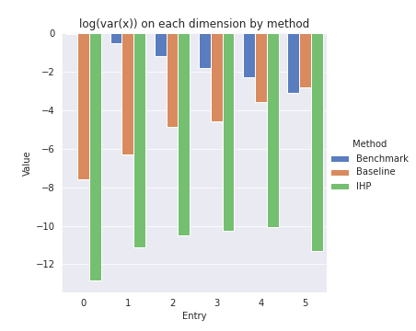
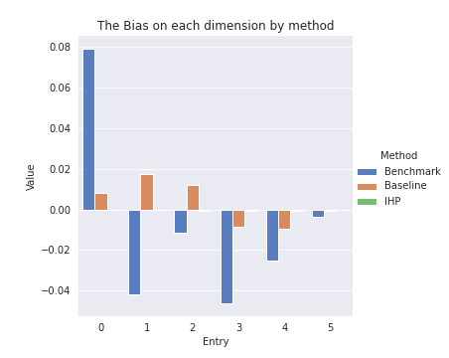
Bias and Variance Analysis:
Parametric Model Implementation
The policy is implemented in a 6-variable parametric model, where the variables are the limiting distribution for all the state s. All the theoretical derivations are available in our github repo (at the end of the slide).
The result supports our statement that our implementation do have the bias and variance order in each entry. The bias difference is of order 10², and variance is of order 10⁴

Slide 8
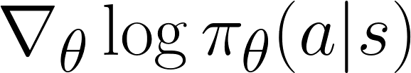
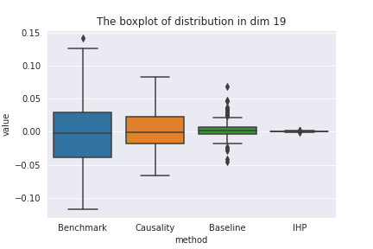
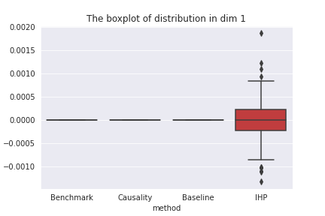
Variance analysis:
Neural Network Implementation
is obtained from auto-diff
The policy is a 20-variable-NN:
takes in the one-hot encoding of state
output the probability of actions
the probability is applied to a categorical distribution and sampled
The variance analysis showed that the newly implemented method have:
A smaller magnitude (thus a smaller length variance), in the meantime the entry-wise value of IHP is close to the true value
A smaller direction variance (measured by the trace of covariance matrix of normalized gradient), which is very important in the optimization.

Slide 9
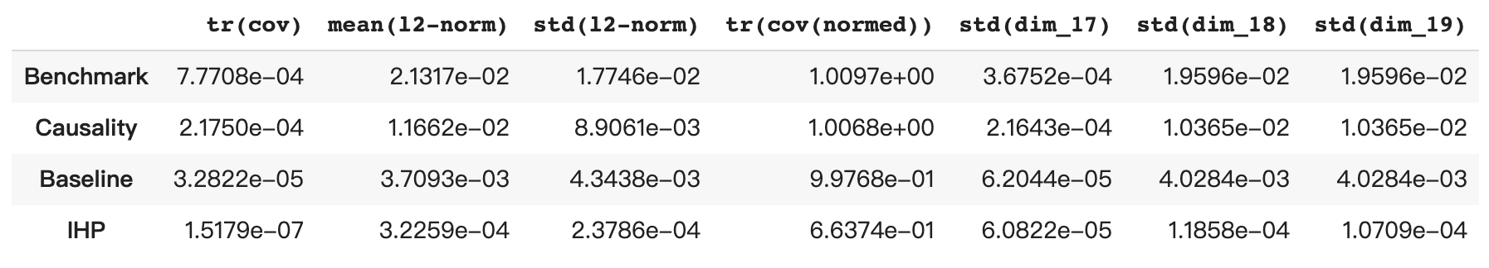
Variance analysis:
Neural Network Implementation
columns:
tr(cov): trace of covariance matrix, the general variance
mean(l2-norm): the magnitude of gradient
std(l2_norm): the std.dev of the magnitude
tr(cov(normed)): trace of covariance matrix of the normalized gradient, the variance in the direction
Notes:
All the result are repeated for 50 times, the results are all in the same pattern.

Slide 10
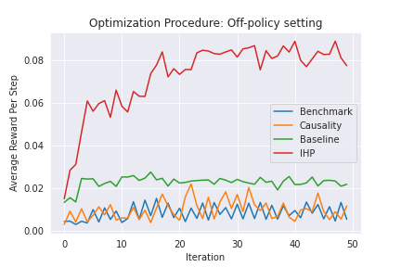
Optimization Analysis:
Neural Network Implementation, off-policy
All the methods shares the same rollout record.
All the gradients are normalized to l2-norm = 1.
In the off-policy setting, the method we implemented overperformed all the benchmarks.
The experiments are repeated for 50 times for different weight initialization, the advantage of IHP method is consistent(50/50).

Slide 11
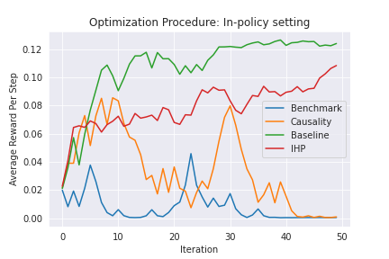
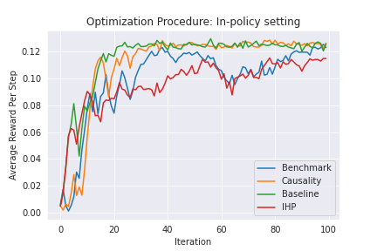
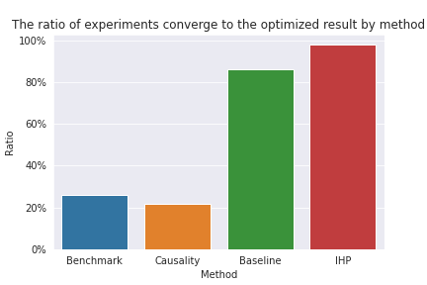
Optimization Analysis:
Neural Network Implementation, in-policy
The gradient estimator we implemented can also be applied in the in-policy scenario:
IHP promised a stable improving trend, it hardly (1/50) falls to the "pit", which is the best among all four methods.
What should be noticed is that the IHP gradient method seems converges to a lower optimum than all the benchmarks, this behavior is consistent(49/49).

Slide 12
Thank you!
All the source code can be obtained from https://github.com/alexliyihao/infinite_horizon_policy_gradient

